Slide 1
Welcome to Open House
Mrs. Conklin’s
Parent Orientation
2018-2019

Slide 2
Cobb County’s Belief Statements
Vision Statement
One Team , One Goal : Student Success
Mission Statement
Empowering all students to pursue their dreams.

Slide 3
Powers Ferry’s Belief Statements
Our Vision
Engaging and empowering our students, families, and community for success.
Our Mission
Growing character and knowledge to achieve dreams for the future.
Our Creed
My character and knowledge direct and determine my future.

Slide 4
About Mrs. Conklin
I am married and have 2 daughters. I have been teaching for 22 years. I’ve taught Kindergarten , 1st and 2nd grade. I have taught at Powers Ferry for 4 years.

Slide 5
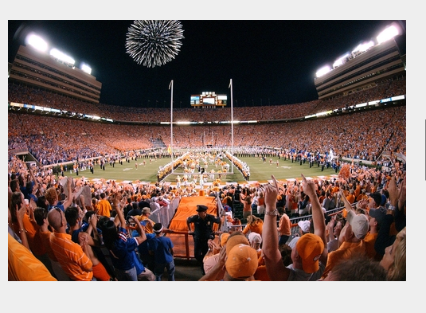
About Mrs. Conklin
I am originally from Tennessee. I graduated from the University of TN, Knoxville with a Master’s degree in Elementary Education.

Slide 6
School Wide Behavior Plan

Slide 7
Mrs. Conklin’s class rules and behavior system 1. Follow directions the first time they are given. 2.Ignore inappropriate behavior. 3. Always do your best and complete your work. 4. Show respect for yourself and others. 5. Keep hand and feet to yourself.
Clip It! Behavior system
Start each day on Ready to Learn. Can move up or down through out day depending on behavior.
Encourage positive behavior and discourage negative behavior.

Slide 8
Positive and Negative Consequences
Positive Consequences: Negative Consequences:
Eating lunch in the classroom - Not being able to eat in the classroom
Class job participation - Losing some or all of recess
Positive note or call home - Behavior Form- self assessment
School/Class celebrations - Note or call home or office visit
Earning dojo points/paw bucks
for rewards

Slide 9
Attendance & Transportation
Please make sure that your child is ON TIME for school each day!
If there is a change in how your child is going home, please send a DATED note or fax to the school. All afternoon transportation changes must be in writing.

Slide 10
Tardies & Absences
School starts at 7:50 a.m.
Running late? Check in at the school office before coming to class.
Please send an excuse for your child’s absence within 3 days of their absence.
After 3 or more unexcused absences, you may be contacted by the school’s social worker.

Slide 11
Daily Folder
The yellow homework folder will go home each day.
This is a vital Home-School communication tool!
It contains daily homework, a monthly school calendar with specials noted and a daily behavior chart.
Please initial the behavior chart each day to indicate that you have seen the daily report.
If you have any questions or concerns, please be sure to write a note to me or send me an e-mail at heather.conklin@cobbk12.org

Slide 12
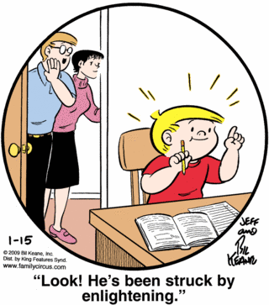
Homework
A homework packet with a weekly newsletter will come home on Mondays and is due on Fridays.
Please allow your child to attempt the homework on his/her own. Please assist with reading directions and then check all completed work.
Please read with your child each night.
The reading practice is the MOST IMPORTANT part of homework!

Slide 13
Report Cards
Second grade report cards are standards-based . The report cards are similar to the first grade report cards from last year.
Conference week will be October 15-19. At this time, we will discuss your child’s report card for the 1st 9 weeks of school.

Slide 14
Progress Reports Progress reports will come home each quarter at the 4 ½ week mark. This will let you know how your student is progressing. There will be lots of “2”s due to we are still working on certain skills that will not be mastered till end of year. N/A means we have not covered yet. Anytime you have a concern or question about progress reports or report cards, please notify me and we will set up a conference.

Slide 15
Our Daily Schedule 7:15-8:00 – Breakfast, Morning Work, Announcements 8:00-9:15 Math Workshop 9:15- 9:55 Content 9:55-10:50 Reading Workshop 10:50- 11:40 Specials 11:58-12:28 Lunch/Recess 12:30-1:40 Writing Workshop 1:40-2:05 Phonics/Intervention 2:05- 2:15 Announcements/Pack up 2:15-2:20 Dismissal

Slide 16
Specials Schedule Day 1: Music Day 2: P.E. Day 3: Art Day 4: P.E.

Slide 17
Math, Reader’s and Writer’s Workshop
Here at Powers Ferry, we use the “workshop” model for teaching.
This means we start with a mini-lesson (10-20 minutes), this is modeling and teaching the standard we are working on. During math, we start with daily problem solving.
Next is the work time ( 10-45 minutes). Here the students might be working independently on the standard, conferring with teacher, be in guided/strategies groups and/or centers.
Last is sharing and closing (5-15 minutes). During sharing , students might read in the Author’s chair (writing), show how they worked a math problem (math) or read from a book (reading). In closing, we review what we have learned for the day and do a quick check for assessment. (Ticket out the door)

Slide 18
Classroom Supplies
Bring these items Don’t bring these items
- wooden pencils - electronic devices or toys
- paper - mechanical pencils
- erasers - hand held pencil sharpeners
- Kleenex tissues
Classroom supplies are used as community resources. That means we share the pencils, scissors, crayons and paper that you purchased.

Slide 19
Keep Your Learner Energized, Comfortable, and Safe!
Please remember to send a healthy snack to school each day.
Please also send a jacket or sweater each day and make sure your child has appropriate shoes for P.E. and the playground.

Slide 20
Medical Information
Please alert the nurse and myself if your child has asthma, is allergic to peanuts or has any other health concerns.
Parents must fill out a medical form before sending your child to school with medication ( i.e. cough drops, inhalers…)

Slide 21
Websites you can access at home:
ABCya.com
Raz-Kids.com
http://www.cobbk12.org/powersferry/
- There are great videos on math on our website
Mrs. Conklin’s blog:
https://www.mrshconklin.weebly.com
I will be sending home a list of usernames and passwords in the next weeks.

Slide 22
Please feel free to contact me anytime. You may email me at heather.conklin@cobbk12.org , called the school and leave a message 770-578-7936 or write me a note .

Slide 23
Thank you for coming!!

